Slide 1
Tutorial - 4
Arithmetic and Logic Instructions

Slide 2
Question-6
Explain the result of the following set of instructions ?
a) li $s0, -2147483648 b) li $s0, -2147483648
li $s1 , 2147483647 li $s1 , -2147483647 div $s2,$s0,$s1
div $s2 $s0,$s1 rem $s3,$s0,$s1
rem $s3,$s0,$s1
c) lui $s0, 32768
lui $s1 ,1
divu $s2 $s0,$s1
remu $s3,$s0,$s1

Slide 3
Question-6
Q6 . Sol :
a) This is signed number operation.o/p quotient -1 and Remainder -1. NO overflow actual o/p and expected o/p are same.
b) This is signed number operation.o/p quotient 1 and Remainder -1. NO overflow actual o/p and expected o/p are same.
c) o/p quotient 32768 and remainder 0.”No carry as the o/p is within the range of numbers that can be represented by using the unsigned number representation. actual o/p and expected o/p are same.

Slide 4
Tutorial - 5
Floating point numbers & Operations

Slide 5
Question-9
The IEEE single precision floating point standard allows us to represent less
than 232 different numbers. Of these numbers:
(a) How many are strictly between 2⁻⁵ and 2⁻⁴ ?
(b) How many are strictly between 2¹³ and 2¹⁴ ?
(c) How many are strictly between 2⁴⁷ and 2⁴⁸ ?

Slide 6
Question-9
Sol:
For all three questions, the answer is 2^23 − 1 different floating point numbers.
For example, between 2⁻⁵ and 2⁻⁴ there are all the floating point numbers with 127 − 5 = 122 = (0111 1010)2 as the exponent and 1 as the sign bit.
Since there are 2^23 bits in the significand, and any setting of these produces a valid FPN, there are 2^23 different FPNs.
We exclude the number with significand all 0 s, since this is the value 1.0×2⁻⁵ .
Thus the solution 2^23 − 1

Slide 7
Question-10
Approximate the decimal number 43.00008 as a normalized binary number in scientific notation,
with ten bits of significand.

Slide 8
Question-10
Sol :
To approximate 43.00008 as a normalized binary number in scientific notation,
we first convert the part to the left of the decimal point to binary.
Converting 43 to binary is 101011.
Further converting the number to 10 bits of required significand :
43.08₁₀ = 101011.(00008)₁₀
= 1010110.(00016)₁₀ ∗ 2⁻¹
= 10101100.(00032)₁₀ ∗ 2⁻²
= 101011000.(00064)₁₀ ∗ 2⁻³
= 1010110000.(000128)₁₀* 2⁻⁴
at this point we have the required
eight bits of significand. So, 43.00008 ≈ 1.010110000 ∗ 2⁹ ∗ 2⁻⁴ = 1.010110000 ∗ 2⁵

Slide 9
Tutorial -6
Floating point numbers & Operations

Slide 10
Question -6
Q.‘E’ represents the biased exponent field in IEEE double precision format, the decimal value range of E for representing the implicit number(except special values like (± 0, ± ∞, and NaN) is….

Slide 11
Question -6
Sol.
E is of 11 bits, we know that if all 11 bits are used then it represents a special number likewise if all are 0.
so Emin = 00000000001 , Emax = 11111111110.
Hence, E is 1<=E<=2046.

Slide 12
Question -7
In IEEE754 single precision floating point format, how many numbers can be represented in the interval [10, 16)?

Slide 13
Question -7
Sol:
10₁₀= 0 10000010 01…..(21 0’s)
16₁₀= 0 10000011 (23 0’s)
Given range is from 10 inclusive to 16(exclusive)
Hence keeping the exponent value same
The number of ways mantissa can be filled for 10 is 2²¹ and for 16 is 2²³.
The sum of the two ways 2²¹ + 2²³ = 2²¹ (1+2)=3* 2²¹ is the answer.

Slide 14
Tutorial - 7
Pipelined Processor Design

Slide 15
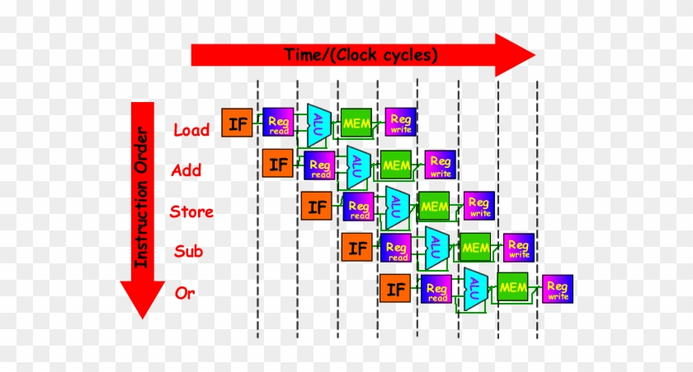
Introduction
Pipelining
In pipelined architecture hardware of the CPU is split up into several functional units.

Slide 16
Introduction
Pipelining
In pipelined architecture hardware of the CPU is split up into several functional units.
Each functional unit performs a dedicated task.
The number of functional units may vary from processor to processor.
Control unit manages all the stages using control signals.

Slide 17
Question-1
Q. If pipelining stages are perfectly balanced ,then the time per instruction on the pipelined processor assuming ideal conditions is equal to ??
b) Pipeline CPI and ideal CPI are related as ??

Slide 18
Question-1
Q. If pipelining stages are perfectly balanced ,then the time per instruction on the pipelined processor assuming ideal conditions is equal to ??
b) Pipeline CPI and ideal CPI are related as ??
Time per instruction on
unpipelined machine-Number of
pipe stages.
Pipeline CPI = Ideal pipeline CPI + structural stalls + Data hazard stalls + control stalls.

Slide 19
Question-2
Q. Consider a pipeline having 5 phases with duration 45, 50, 55,60 and 75 ns. Given latch delay is 5 ns.
Calculate-
Non-pipeline execution time
Sequential time for 500 tasks

Slide 20
Question-2
Q. Consider a pipeline having 5 phases with duration 45, 50, 55,60 and 75 ns. Given latch delay is 5 ns.
Calculate-
Non-pipeline execution time
Sequential time for 500 tasks
Sol:
a)Non-pipeline execution time for one instruction 45 ns + 50 ns + 55 ns + 60 ns +75 ns
= 285 ns.
b) Non-pipeline time for 500 tasks
= 500 x Time taken for one task
= 500 x 285 ns
= 142500 ns

Slide 21
Question-3
Q.
a) Consider the description given in the following table.
If the time for a ALU operation can be shortened by 50% compared to the description given in the table.
Will it affect the speedup obtained from pipelining ? If yes , by how much ?otherwise ,why ??
What if the data access operation now takes 25% less time ?
Instruction Class | Instruction fetch | Register read | ALU operation | Data access | Register write | Total time
Load word (lw) | 200ps | 100ps | 200ps | 400ps | 100ps | 1000ps
Store word(sw) | 200ps | 100ps | 200ps | 400ps |  | 900ps
R-format(ad d,sub,and,or ,slt) | 200ps | 100ps | 200ps |  | 100ps | 600ps
Branch(beq) | 200ps | 100ps | 200ps |  |  | 500ps

Slide 22
Question-3
Q.
Will it affect the speedup obtained from pipelining ? If yes , by how much ?otherwise ,why ??
What if the data access operation now takes 25% less time ?
Sol:
a) Shortening the data access operation by 50% will not affect the speedup obtained from pipelining .It would not affect the clock cycle.
b) If the data access operation takes 25% less time ,it still is a bottleneck in the pipeline. The clock cycle needs to be 300ps. Hence speedup would be 400/300 which is 1.33 i.e. 0.33 increase in the speed… Hence the speedup would be 33% more.

Slide 23
Question-4
Q.
A computer architect needs to design the pipeline of a new microprocessor .He has an example workload program with 10⁶ instructions. Each instruction takes 100ps to finish.
a)How long does it take to execute this program on a non pipelined processor?
b)Real pipelining is not perfect , since implementing pipelining introduces some overhead per pipeline stage .will this overhead affect instruction latency, instruction throughput ,or both?

Slide 24
Question-4
Q.
A computer architect needs to design the pipeline of a new
microprocessor .He has an example workload program with 10⁶
instructions. Each instruction takes 100ps to finish.
a)How long does it take to execute this program on a non pipelined processor?
b)Real pipelining is not perfect , since implementing pipelining introduces some overhead per pipeline stage .will this overhead affect instruction latency, instruction throughput ,or both?
Sol
a)It takes 100ps * 10⁶ = 100 microseconds to execute on a non pipelined processor ( ignoring start and end transients in the pipeline).
b)Pipeline overhead impacts both latency and throughput.

Slide 25
Question-5
Q. A program takes 500ns for execution on a non-pipelined processor .suppose we need to run 100 programs of the same type on a 5-stage processor with a clock period of 20ns .
what is the speed-up ratio of the pipeline?
What is the maximum achievable speed-up?
Assume the instruction cycle takes five clocks.

Slide 26
Question-5
A program takes 500ns for execution on a non-pipelined processor .suppose we need to run 100 programs of the same type on a 5-stage processor with a clock period of 20ns .
what is the speed-up ratio of the pipeline?
What is the maximum achievable speed-up?
Assume the instruction cycle take five clocks.
Sol:
Instruction cycle of 5 clock cycles
with 20ns cycle time would take
20 x 5 =100ns for one instruction.
=> no of instructions in the program
= 500ns /100ns =5.
time taken for executing 100 such programs on a non pipelined processor
=5 *100 * 100 ( instructions in program * no of program * execution time of one program on a non-pipelined processor)

Slide 27
Question-5
A program takes 500ns for execution on a non-pipelined processor .suppose we need to run 100 programs of the same type on a 5-stage processor with a clock period of 20ns .
what is the speed-up ratio of the pipeline?
What is the maximum achievable speed-up?
Assume the instruction cycle take five clocks.
Sol: contd....
time taken for execution of 100 programs on a pipelined processor
= [no of stages of a pipeline + (total no of instructions -1)] clock cycle time of pipeline .
= [ 5 + (5*100) -1] *20.
Speedup = 5 * 100 * 100 = 5 * 100 *100 = 2500 [ 5 + (5*100) -1] *20 504 * 20 504
= 4.96
The maximum achievable speedup is n = no of stages of the pipeline =5

Slide 28
Additional execrise problems

Slide 29
Question-6
The instruction pipeline of a RISC processor has the following stages: Instruction Fetch (IF), Instruction Decode (ID), Operand Fetch (OF), Perform Operation (PO) and Writeback (WB), The IF, ID, OF and WB stages take 1 clock cycle each for every instruction. Consider a sequence of 100 instructions. In the PO stage, 40 instructions take 3 clock cycles each, 35 instructions take 2 clock cycles each, and the remaining 25 instructions take 1 clock cycle each. Assume that there are no data hazards and no control hazards.
Calculate the total number of clock cycles required for completing the execution of the 100 instructions ?

Slide 30
Tutorial-7 Pipelined Processor Design
Q5. The instruction pipeline of a RISC processor has the following stages: Instruction Fetch (IF), Instruction Decode (ID), Operand Fetch (OF), Perform Operation (PO) and Writeback (WB), The IF, ID, OF and WB stages take 1 clock cycle each for every instruction. Consider a sequence of 100 instructions. In the PO stage, 40 instructions take 3 clock cycles each, 35 instructions take 2 clock cycles each, and the remaining 25 instructions take 1 clock cycle each. Assume that there are no data hazards and no control hazards.
Calculate the total number of clock cycles required for completing the execution of the 100 instructions ?

Slide 31
Tutorial-7 Pipelined Processor Design
Sol:
i) Given, total number of instructions (n) = 100 Number of stages (k) = 5
Ideal pipeline clock cycles = k + n - 1= 5+100-1= 104
Stall cycles due to PO instructions = 40 * (3 -1) + 35 * (2 -1) = 80 + 35 =115 Total number of clock cycles required to execute the 100 instructions will be Ideal pipeline clock cycles + Stall cycles = 104 +115 =219.

